Slide 1

A Big Pile of JSON or
How AJAX MAGIC can improve your applications
Jared Faris
@jaredthenerd
jared@jaredthenerd.com
Image By Tribe Toba Batak
Notes:
By Tribe Toba Batak, Sumatra, Indonesia [Public domain], via Wikimedia Commons
http://commons.wikimedia.org/wiki/File:Book_of_Wizards_Batak_Indonesia.jpg

Slide 2
About me
The least interesting part of the talk
Notes:
HMB – two roles, Columbus
Microsoft MVP with the Internet Explorer team (yay web technologies)
Total geek/nerd – board gamer, video gamer, etc

Slide 3
Topics
JSON
AJAX
REST
Organizing Apps
APIs
Real-time
Testing
Notes:
You’ll hopefully leave with a better handle on how to structure your apps to make it easier to build rich user experiences. This should be helpful whether you’re building JS heavy apps with something like Angular, or building smaller components that will live in an existing server-side heavy app

Slide 4
So What Is JSON?
“JSON (JavaScript Object Notation) is a lightweight data-interchange format. It is easy for humans to read and write. It is easy for machines to parse and generate.”
- json.org
Notes:
It was first formalized and popularized by Douglas Crockford

Slide 5
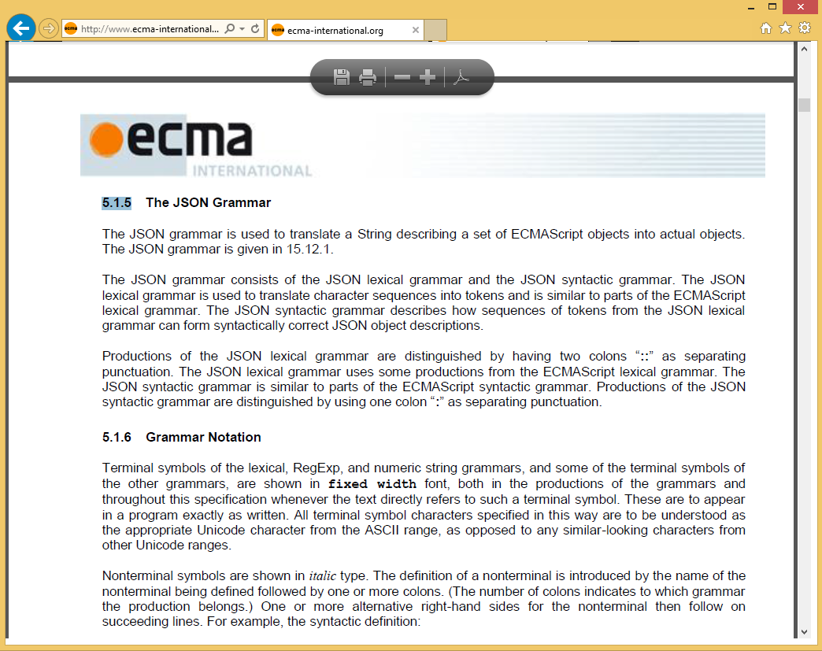
The Spec
Notes:
Let’s take a few minutes to read through the 258 page ECMA spec.
Or maybe, let’s talk about what JSON is practically

Slide 6
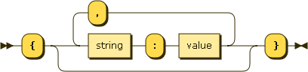
JSON Components
Key-Value Pairs
{
name: “JaredTheNerd”,
class: “Nerd”
}
Notes:
Image generated by http://www.bottlecaps.de/rr/ui
Grammar: object ::= '{' ((string ':' value ) ( ',' string ':' value )*)? '}'

Slide 7
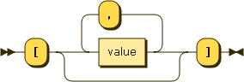
JSON Components
Arrays
items: [
“SSD of holding”,
“blue plaid shirt”
]
Notes:
Image generated by http://www.bottlecaps.de/rr/ui
Grammar: array ::= '[' ((value ) ( ',' value )*)? ']'

Slide 8
JSON Components
typeof “Key” => “string”
typeof “Value => “string”
“number”
“bool”
“null”
“array”
“object”

Slide 9
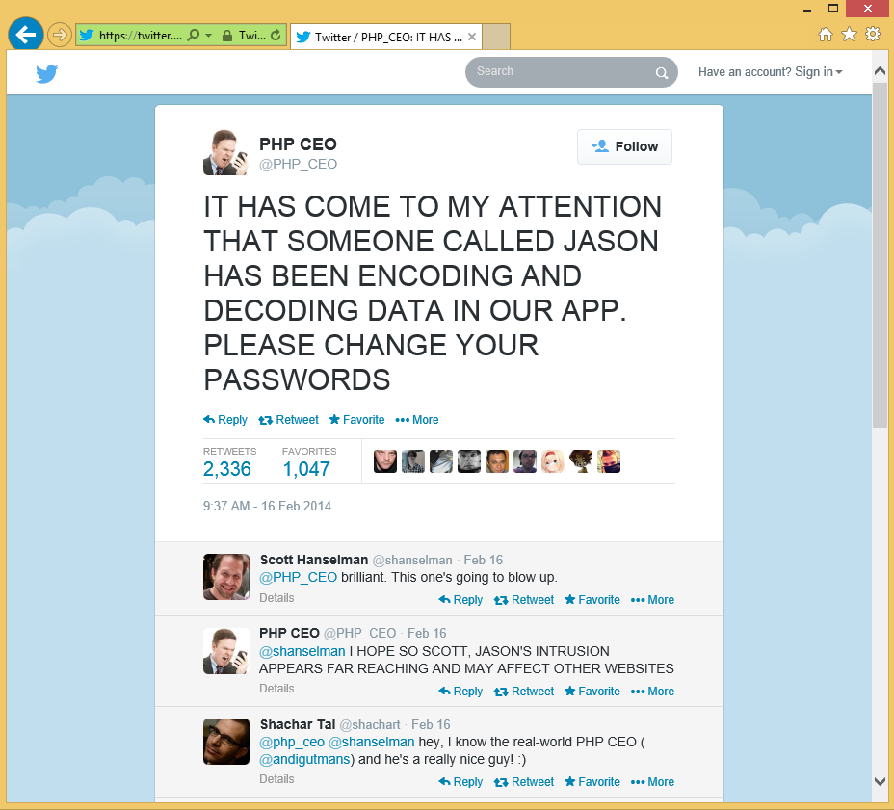

Slide 10
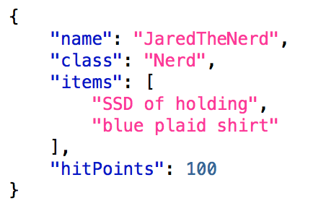
Valid JSON
Notes:
It has basic structures and is easy to parse as a human or a computer. It’s pretty much universally supported by modern development languages. As a bonus, when using it with JavaScript and using primitive types, you can mentally treat JSON and JavaScript objects about the same

Slide 11
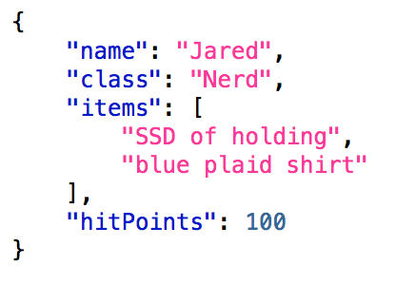
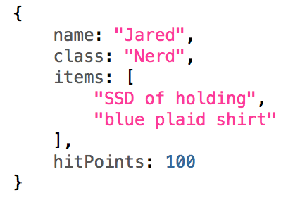
JSON JS Obj
Notes:
JavaScript object’s always have keys that are strings too although they aren’t quoted.

Slide 12
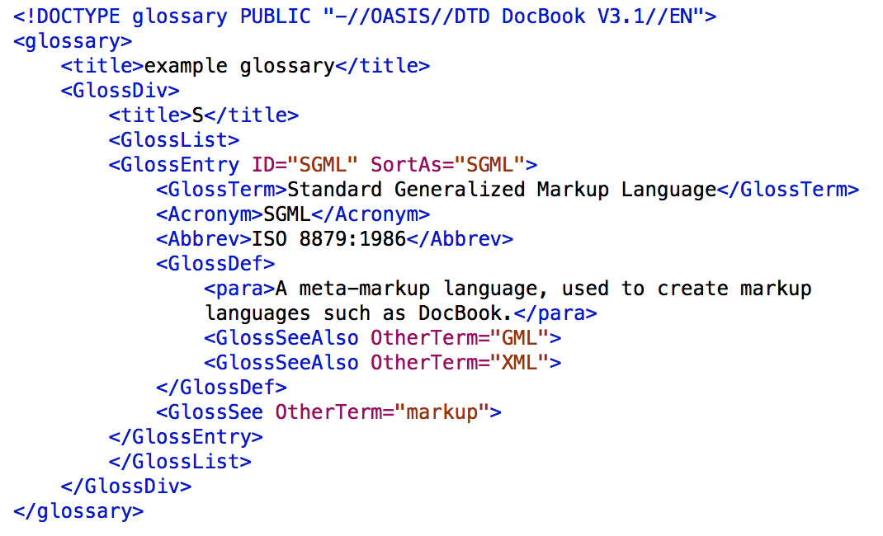
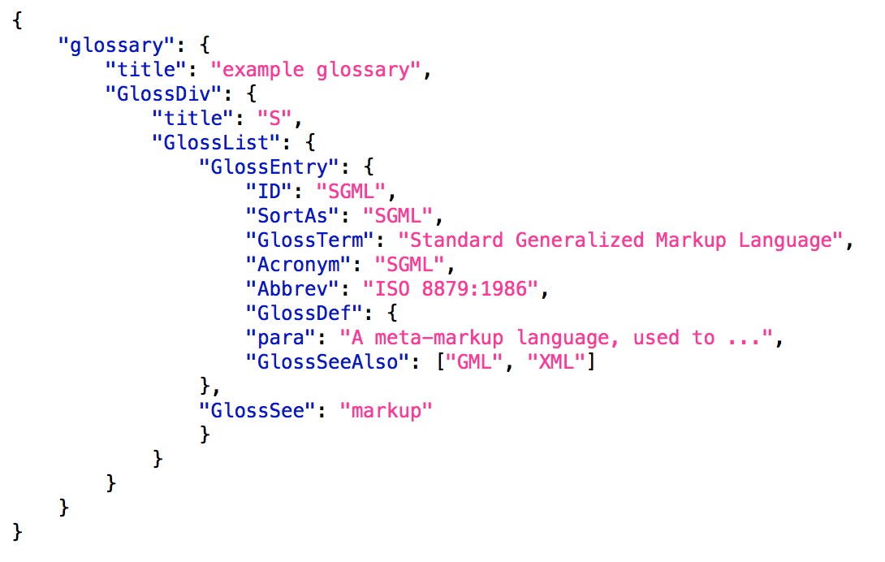
What JSON Isn’t?
Example from: http://json.org/example.html
Notes:
Let’s pivot this a bit and show what it is not: It’s not XML!
JSON is a simpler format than XML.

Slide 13

“Some languages can be read by humans, but not by machines, while others can be read by machines but not by humans. XML solves this problem by being readable to neither.” - Unknown
Photo by Hans
Notes:
http://pixabay.com/en/puzzle-unfinished-cardboard-box-55882/
CCO 1.0 Universal – Public Domain

Slide 14
Limitations
No complex data types
No contracts
Notes:
[two clicks]
With XML, you can define complex data types and have each end of a conversation understand them. JSON has no built in support for that
Unlike XML which has SOAP as a specification for describing XML messages, JSON currently doesn’t have anything similar.

Slide 15
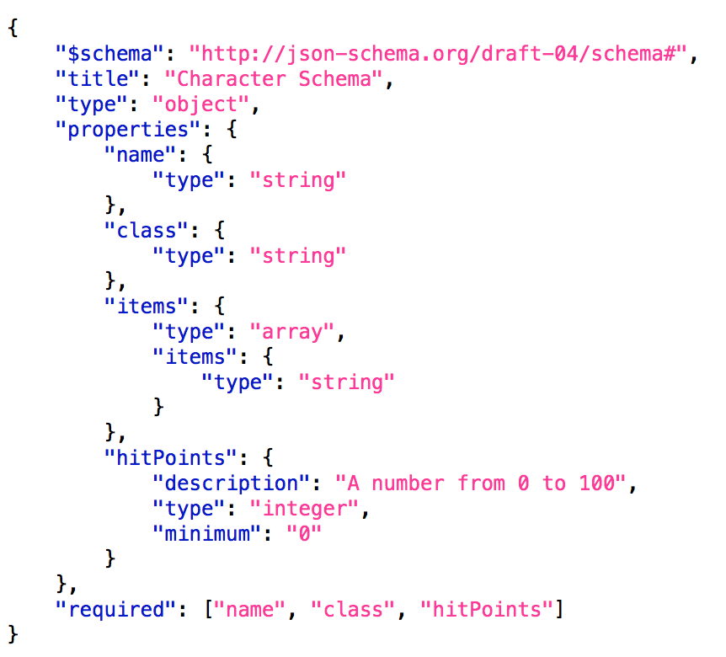
JSON Schema
Notes:
The JSON Schema project has come up with a format that you can use to explicitly define your JSON. I personally haven’t seen this widely used yet but it’s something to be aware of
We won’t be looking at it more today.

Slide 16
How We’ve Built Apps

Slide 17
Forms
POST
RESPONSE
Notes:
[4 clicks]
A traditional page interaction involves forms that POST to a server.
The server thinks through things, and returns with a new page via the response.
The user does whatever happens on his/her end and then POSTs back.

Slide 18
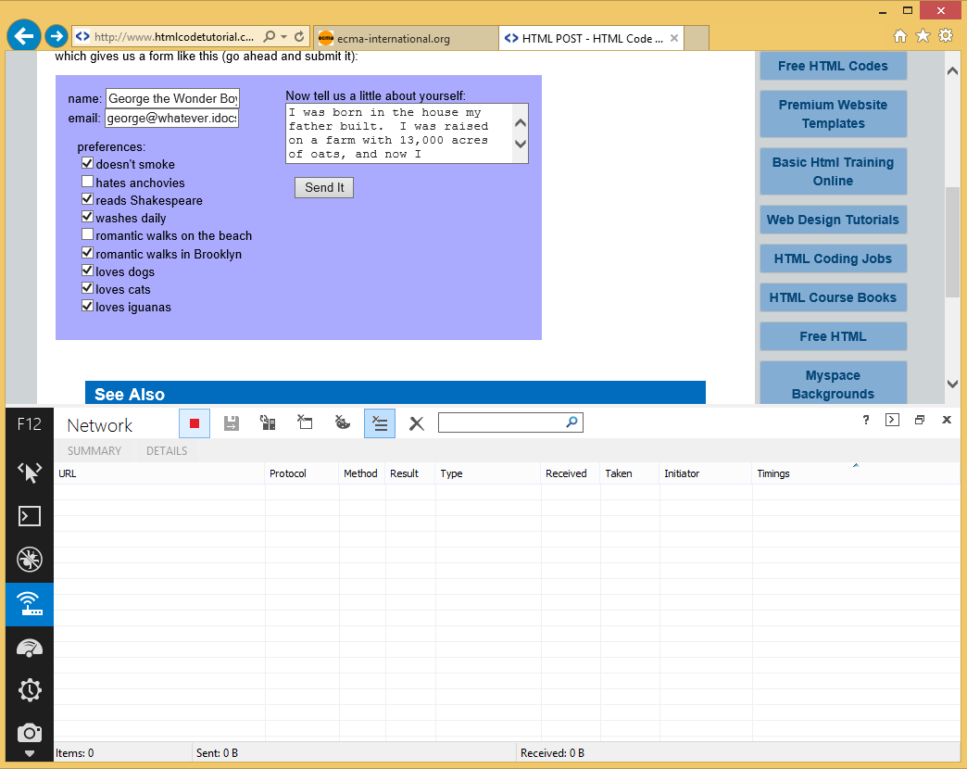
Forms

Slide 19
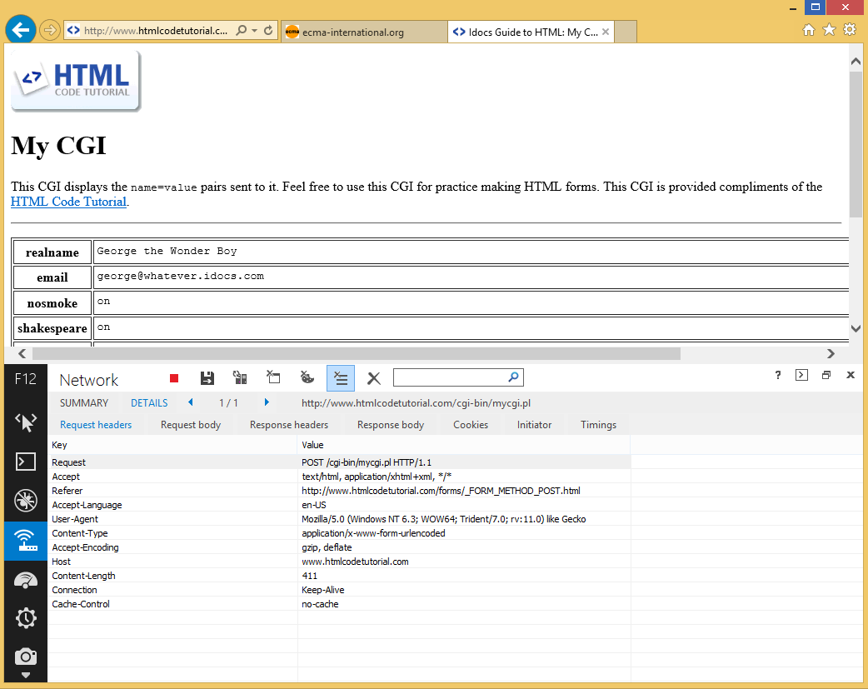
POST Data
Notes:
An entire HTML document gets sent back. This is overkill for a lot of things we need to do and thus, the need for AJAX was born

Slide 20
POST Data
Notes:
It also makes it hard to build interesting on-page behaviors because the state of the page is getting trashed every time the user does anything. In the past, we’ve build different ways to handle this, but they all were pretty clunky until we started using AJAX

Slide 21
How Developers Learn AJAX
Get HTML from the server
Dump it into the page
$(‘#target’).load(‘/some/path’);
Notes:
We use a bit of jQuery, or some plugin that does AJAX under the hood. We use it to just fill out a div with stuff and don’t really understand what’s happening behind the scenes.
How many people interact with JavaScript and AJAX this way, with purchased controls or downloadable plugins? In the enterprise, I suspect it’s a majority of folks.

Slide 22
Beginner AJAX
GET
RESPONSE
POST
RESPONSE
RESPONSE
POST
Main Action
Partial Action
Notes:
When we first start using AJAX, we tend to wire up a page load
Then, when people interact with the page, we use a single bundle of JS that does anything after the page load. For instance, this could be a page loading with a data grid. Grid interactions go through some backend endpoint after the page loads.
Even if there are 5 models, 25 database tables, and 700 classes behind the scenes, we wire up a small number of asynchronous endpoints to load data

Slide 23
AJAX Continued
Get JSON from the server
Write some HTML into the page
$.ajax({
url: “/some/url”
}).done(function(data){
// some code
});
Notes:
Then maybe we build some custom controls that hit our own endpoints and load up HTML partials that get inserted into the document
As we get a bit more advanced, the endpoints just return data and not presentation but we are still probably using purpose-built endpoints

Slide 24
Advanced AJAX
Begin using JavaScript frameworks like Angular, Knockout, Backbone, etc
Connect the client-side to RESTful endpoints
Profit!
Notes:
When you look at JavaScript frameworks, this is probably what you see. They make it seem very obvious how you should structure your app to build their tool.
Then they give you some nifty example TODO app to look like and send you on your way. They almost never talk to you about how the RESTful endpoints should function.
How do you provide data to the client-side app to let it work? That’s what we’ll talk about next.

Slide 25
REST
Representational State Transfer
Notes:
So I just said “RESTful endpoints”. What does that mean?

Slide 26
Representational state transfer (REST) is an architectural style consisting of a coordinated set of constraints applied to components, connectors, and data elements, within a distributed hypermedia system. - Wikipedia
BLAH BLAH BLAH BLAH BLAH
BLAH BLAH BLAH BLAH BLAH
BLAH BLAH BLAH BLAH BLAH
BLAH BLAH BLAH BLAH BLAH
Notes:
Yawn
Source: http://en.wikipedia.org/wiki/Representational_state_transfer

Slide 27
REST
Nouns
Verbs
Resources
Users
Parts
Messages
Anything that has state
Actions
Create
Read
Update
Delete
Anything that changes state
Notes:
`Rest is a way of thinking about accessing resources on the web in terms of sentences. There are nouns and verbs that act on them

Slide 28
REST
Create a new user
View user details
Update a user
Delete a user
POST /User/
(w/ some body)
GET /User/123
PUT /User/123
(w/ some body)
DELETE /User/123
Notes:
Simplified, when we build a RESTful service we VERB on a NOUN and the data is our adjectives.
“Create a new user named Tina with a green car” is “POST ‘Tina with a green car’ to USER”
[MORE SCROLL DOWN]
It’s not uncommon for PUT/DELETE to not be supported due to firewalling, policy, or some other reason. In this case, people will frequently add something in the querystring to tell the server what verb to use. The call isn’t pure REST, but they can still think in terms of the verbs.
Scott Hanselman recently had a nice blog post about another way using the X-HTTP-Method-Override header in the HTTP request to specify the verb as well. I’ll include that link at the end of this slide deck. If you want to talk more about this lets do so at the end.

Slide 29
Comparison
REST
UNREST
POST /user <body>
PUT /user/123 <body>
POST /user/create <body>
POST /user/update/123 <body>

Slide 30

So what?
And also, HONK!!!
Photo by Richard Croft
Notes:
Why does this matter?
Shortly we’re going to talk about ways to structure your app to make building client-side code easier. A key part of doing this is to start organizing your back end into separate paths to get to different resources. Using the REST pattern will help.
http://commons.wikimedia.org/wiki/File%3AAn_inquisitive_eye_-_geograph.org.uk_-_938117.jpg
Richard Croft [CC-BY-SA-2.0 (http://creativecommons.org/licenses/by-sa/2.0)], via Wikimedia Commons

Slide 31
Route Formats
PUT /User/123?edit=address
PUT /UserAddress/123
PUT /User/123/Address
etc
Notes:
What happens when you need a few different ways to update an object? For instance, you might have pages where the users can edit their entire profile. You might also have places where they can make changes to the address or add a second shipping address or something like that. How do you handle building endpoints to support multiple paths to modify one set of data?
You can format the URLs a few ways:
It could mean you have a querystring parameter you pass to a PUT that tells it the type.
It could be you define separate objects.
It could be an extended route that is more verbose
It could be another way entirely. In any case, you’re still thinking VERB NOUN syntax
Let’s talk about how we start to apply these things to the apps you’re building

Slide 32

Facelifts for Legacy Apps
Photographer Unknown
Notes:
With legacy apps, your data models were already wired up to the UI through various methods:
- embedded in the page
- your server side (like webforms) method of data binding
- some other magic you may not fully understand
There are pitfalls you may face when updating your apps
http://commons.wikimedia.org/wiki/File%3AReconstruction_work_of_Tokyo_station_Marunouchi_building.jpg
See page for author [Public domain], via Wikimedia Commons

Slide 33
Updating Legacy Apps
Asynchronous endpoints are an entirely new pattern
Potentially many ways to access the same data
Notes:
If you build an async method of accessing a certain model, consider updating your app everywhere to use this method. You don’t want to have to maintain two or more ways of doing the same thing

Slide 34
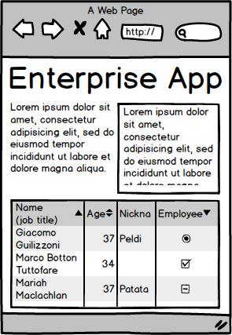
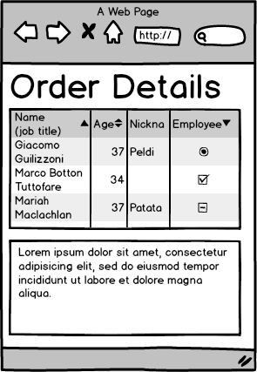
User Page
User Page
Order Page
Order Page
S&R Page
User API
Order API
Shipping API
Receiving API
Notes:
Your pages are probably going to be made up of multiple bits of data. Because of the nature of apps, you’ll probably reuse these objects.
[1 click] On a legacy app, your pages probably have one way of loading some of the data. The widgets you build will likely dynamically access other data that’s not primary to the page [Example: it’s common to add a hover over snapshot view of an item in a details view. To see the full details, users would click]
[2 clicks] Even if you build reusable APIs, you’ll still have to maintain the old way and new way of loading new data
In an ideal world, what you would do at this point is remove the data component of each page’s backing structure.

Slide 35

New Development
Photo by Diliff
Notes:
New apps don’t have these existing patterns but they have their own problems:
- With legacy apps, we tend to know the direction of our product and have an idea of what the future holds
- With new apps, we’re generally figuring it out more as we go
Architecture here is sort of a bad example. The building is fully designed, at least structurally by the time they start construction. Apps almost never are.
By Diliff (Own work) [GFDL (http://www.gnu.org/copyleft/fdl.html) or CC-BY-3.0 (http://creativecommons.org/licenses/by/3.0)], via Wikimedia Commons
http://commons.wikimedia.org/wiki/File%3AQV_Building_construction_site%2C_Melbourne_-_March_2002.jpg

Slide 36
Building New Apps
Each new feature may need bits of similar data to previous features
Very easy to fall for “this one’s slightly different”
Notes:
If you’re not careful, you end up building a dozen different ways to do the same thing

Slide 37
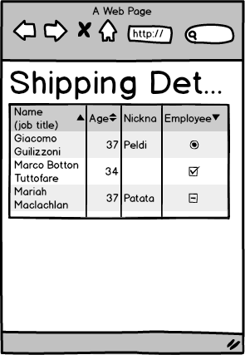
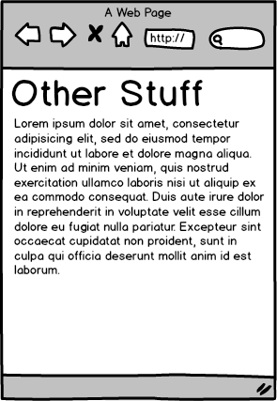
Person Details
Full Person Details
Short Order Det.
Expanded Orders
Etc
Short Person Details
Admin Person Det.
Shipping Order D.
Order List Det.
Etc
Notes:
I worked on a product that had a heavy social interaction component. We ran into this when it came to user details. On some screens, we needed a short name like “Jared F.”.
On other screens, we needed “Jared Faris”.
Still other places needed an email address and an avatar (we used Gravatar as well as uploaded images). Other places had a list of your connections embedded in.
Before long, we were building multiple endpoints to do basically the same thing

Slide 38
Server-side code
The secret of building great client-side code…
Notes:
No, really. Just about every JS framework has client side best practices. In the case of some, like Backbone, others in the community have come up with their own suggestions.
What they always seem to skimp on is how you can structure the rest of your application to make the front-end stuff work. Especially when you’re building large enterprise apps and not small SPAs
There are apps that can operate almost purely client-side, with only the slimmest shim of server-side code. Sadly, I don’t think most line of business apps fit this model.

Slide 39
Redesigning The Server
Identify data types
Identify usage patterns
Define client-side ‘models’
Separate pages/APIs
Re-use APIs
Notes:
We’ll walk through each of these items in detail

Slide 40
Identify Data Types
Look at your server-side models
What properties are exposed?
How are they combined?
Notes:
Start with what data you’re persisting and passing around
Generally you don’t bubble all of that data up to the client side. Sometimes it’s personal information (SSNs), sometimes it’s system info (GUIDs), etc. Figure out which pieces are consumed client-side
Often times your client side controls actually care about a bit of data from a few different models. Identify these combined types because they can become view models

Slide 41
Identify Usage Patterns
Where do these models get used?
Are there usage differences by area?
How are the properties used?
Which ones have logic?
Notes:
Look for objects that get used frequently. Even if you don’t use every property every time the object is loaded, it could be there is no cost to only having one way to load the data. You just disregard some properties sometimes.
Do you have a person object that’s loaded on a ton of pages? Is it currently embedded multiple times in other objects like Orders, Shipping Manifests, etc? Can you load it separately? This sort of model is a great candidate to break into a reusable resource
Are there models that are highly page specific and that have a lot of one off behaviors? Maybe this still lives by itself

Slide 42
Define Client-Side ‘Models’

Slide 43
Separate Pages/APIs
Pages
APIs
Structure
Static content
Media
Data
Interaction
Notes:
You can generally identify pieces of your app that fall under one of these categories. If you can describe them cleanly, you can put them in different places.

Slide 44
Re-Use APIs
Build your JS to assume view models
Ignore data
Cache things that don’t change
Notes:
If you have a standard JSON payload that you return for a person, use it in every widget you build that has personal information.
Sometimes it will have data (like an avatar image URL or something else) that individual widgets don’t care about. If it’s not private/secret, just pass it around always. It’s cheaper to send a few extra bytes over the wire than to maintain multiple pathways.
Some things (like the avatar URL) aren’t going to change frequently. Cache them server side. Consider caching entire requests if nothing is changing so your client can avoid even making calls. If you’re caching server side, remember that you can manually invalidate cache if necessary

Slide 45
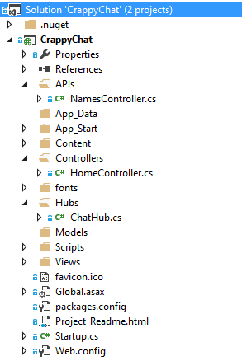
Notes:
Here’s an example app I use for another talk that has APIs, Controllers, and something called Hubs.
Talk about APIs/Controllers.
We’ll talk about Hubs if we get time

Slide 46
Person Details
Full Person Details
Short Order Det.
Expanded Orders
Etc
Short Person Details
Admin Person Det.
Shipping Order D.
Order List Det.
Etc
Notes:
So we should go from this…

Slide 47
Person Details
Order Details
Etc
Notes:
To this:
Build a suite of re-usable APIs for this. Perhaps there are a couple of endpoints on each API controller, or perhaps you pass a query string, but now the logic is all in one place

Slide 48

TWO-WAY REAL-TIME
Photo by Alan Stark
Notes:
Now it’s time to talk about a more advanced topic that becomes easier with some of the work we’ve done. Real-time client-server interactions.
By Alan Stark (Attribution-ShareAlike 2.0 Generic)
http://www.flickr.com/photos/squeaks2569/8115296401/

Slide 49
Multi-User Apps
?
GET
RESPONSE
POST
RESPONSE
Notes:
Most apps have multiple users whose interactions affect each other.
Most apps don’t handle this well.
In a traditional app, for the second user to know about an update, he or she would have to refresh the page. Maaaaybe, there’d be a control polling to check for changes and alert them.

Slide 50
WebSockets
WebSockets allows real-time, two way pipes between clients and servers
Tools like SignalR, SockJS or SocketIO simplify this process
Most apps have real-time problems

Slide 51
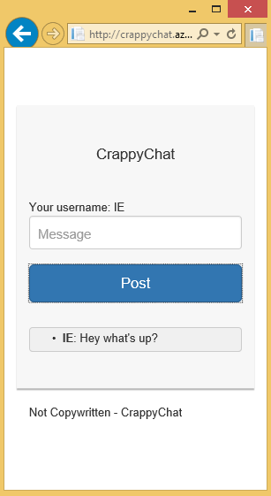
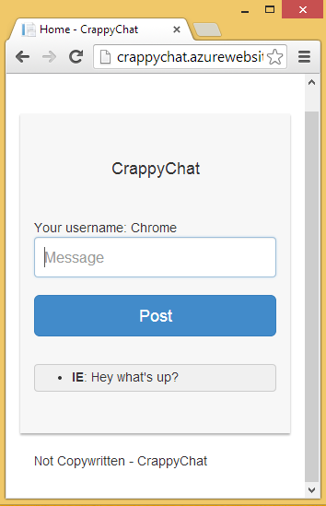
WebSocket Example
Send
Receive
Receive
Notes:
Here’s a slide I stole entirely from my SignalR talk. I’ll be happy to share that if you’re interested.
The data you’re passing back and forth is just JSON. If you build something using your RESTful services, and later change it to be real-time, the hope would be that only your communication layer changes. Model binding would just happen more frequently.
With SignalR, the ‘controllers’ for your websockets are called Hubs. They’d be organized a little differently than your API as well

Slide 52
Tie It All Together
TODO – give an example of a big object graph with little bits of it switched out. This is only possible if you have a well defined ‘standard’ object model

Slide 53

Get Rid of the server-side!
And once you’ve done all that…
Photo by Schwede66
Notes:
Well, not really. If you’ve broken things into logical RESTful endpoints, you can do some interesting testing sans-server.
http://commons.wikimedia.org/wiki/File%3APWC_building_demolition_399.JPG
By Schwede66 (Own work) [CC-BY-SA-3.0 (http://creativecommons.org/licenses/by-sa/3.0)], via Wikimedia Commons

Slide 54
Testing RESTful Endpoints
Fake out the requests
Define standard responses
Test JS behaviors

Slide 55
Fake Out The Requests
Jasmine-Ajax
jQuery-Mockjax
Amplify.JS
Notes:
Jasmine-Ajax is a Jasmine plugin for faking out jQuery Ajax requests from pivotal labs (the people behind Jasmine)
jQuery-Mockjax is a tool agnostic mocking library for faking out jQuery ajax calls
Amplify is a framework for decoupling your data consumer from the AJAX calls all together. Your client widgets make a request in Amplify for data and you wire up a provider separately. You can stub those out in testing.

Slide 56
Define Standard Responses
Identify personas or other use cases
Build a library of these standards
Re-use them in your tests
Notes:
You probably don’t have an infinite number of models or test cases. You probably have test data in a dev/QA database for developing against.
You’re basically doing the same thing here with JavaScript. If you really wanted to, you could script out something that generates your test data from your server-side test data. If you kept it up to date, you could always be testing with realistic cases

Slide 57
Test JS Behaviors
None of your tests care about a server
Party!

Slide 58
?
Notes:
Questions?

Slide 59
Thank YOU!
Jared Faris
@jaredthenerd
jared@jaredthenerd.com

Slide 60
Links
Using X-HTTP-Method-Override
http://bit.ly/1c45htM

